Slide 1
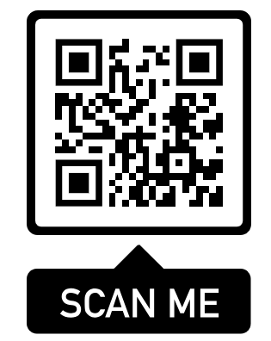
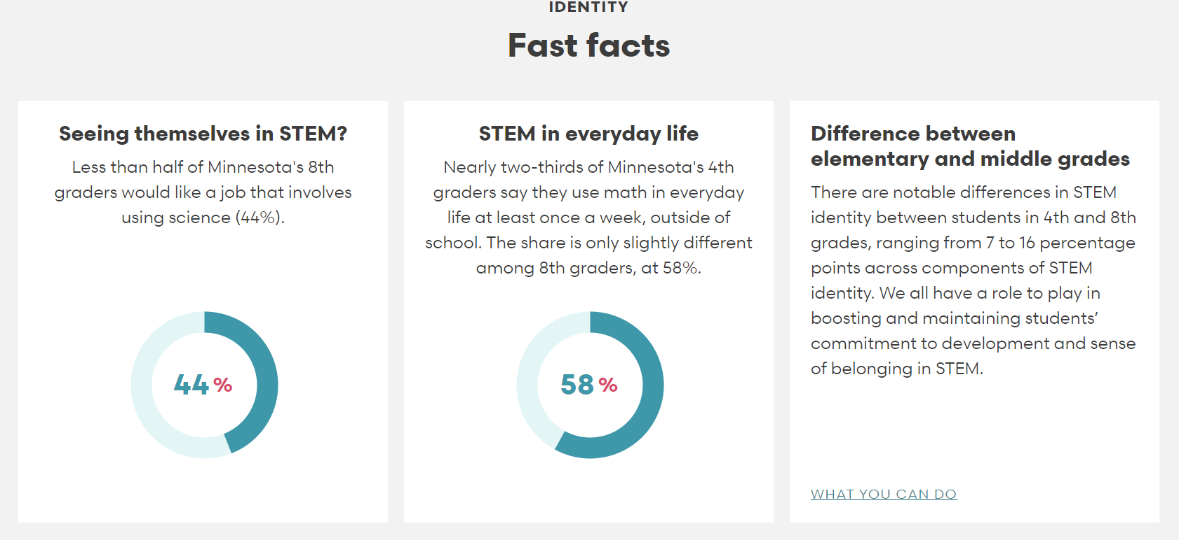
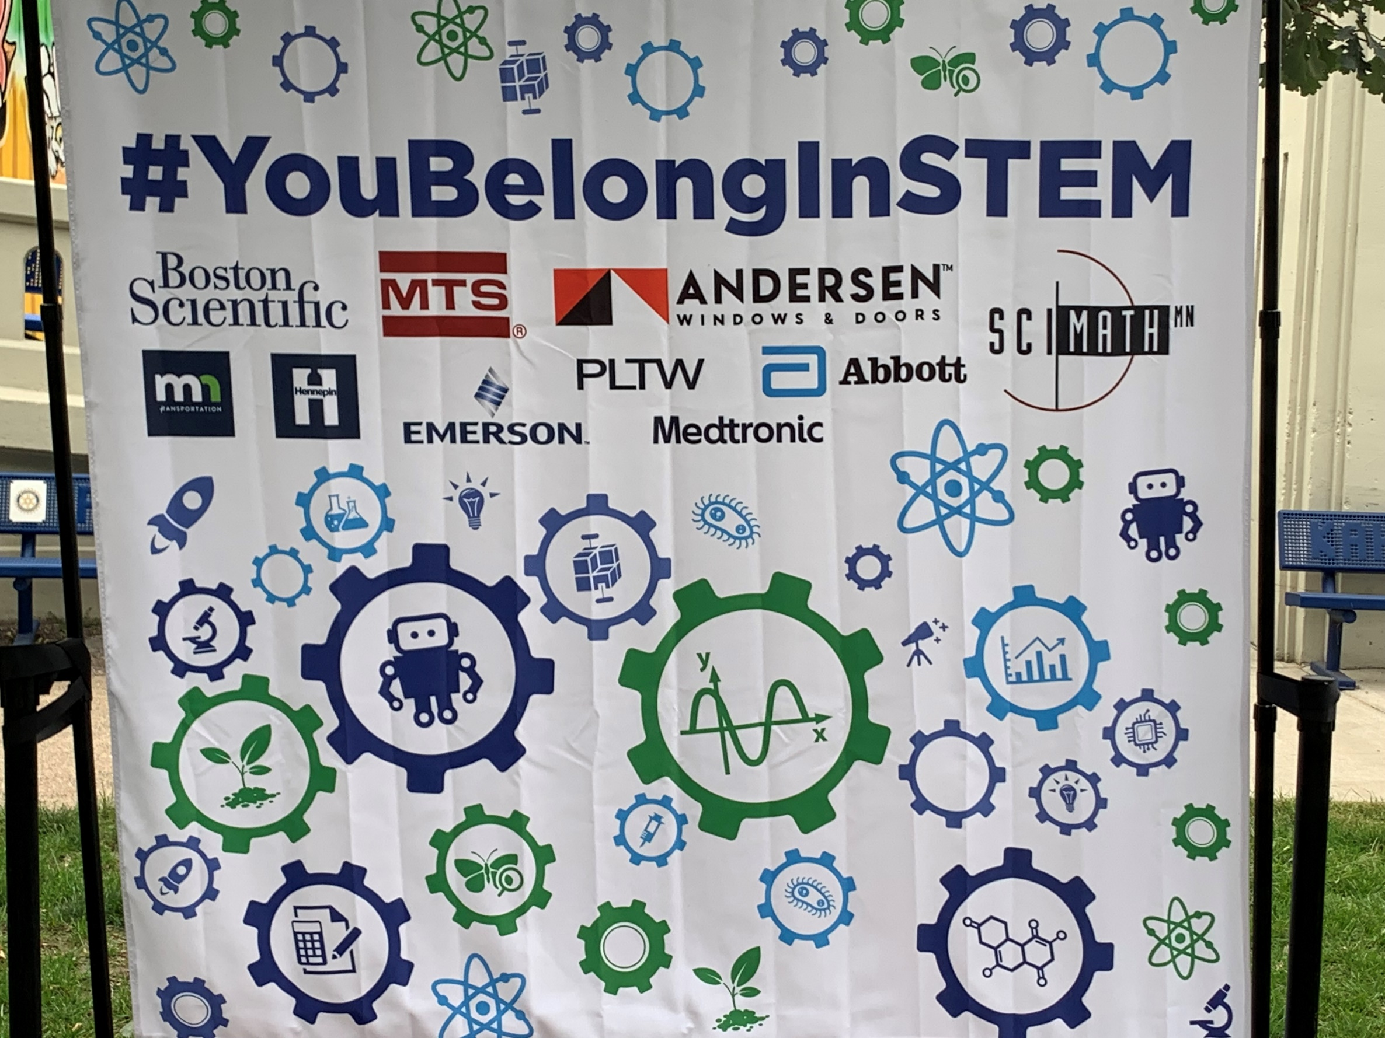
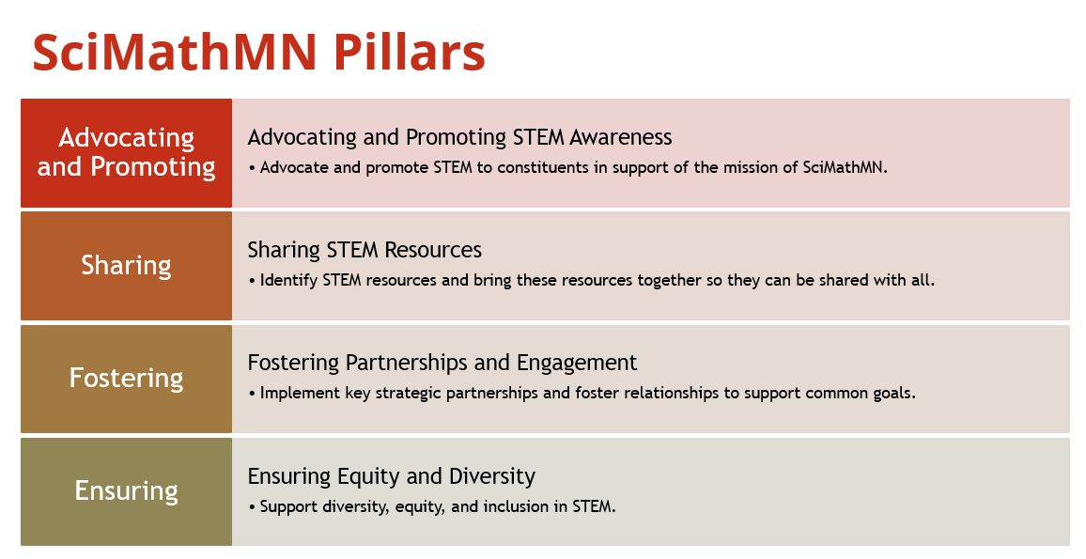
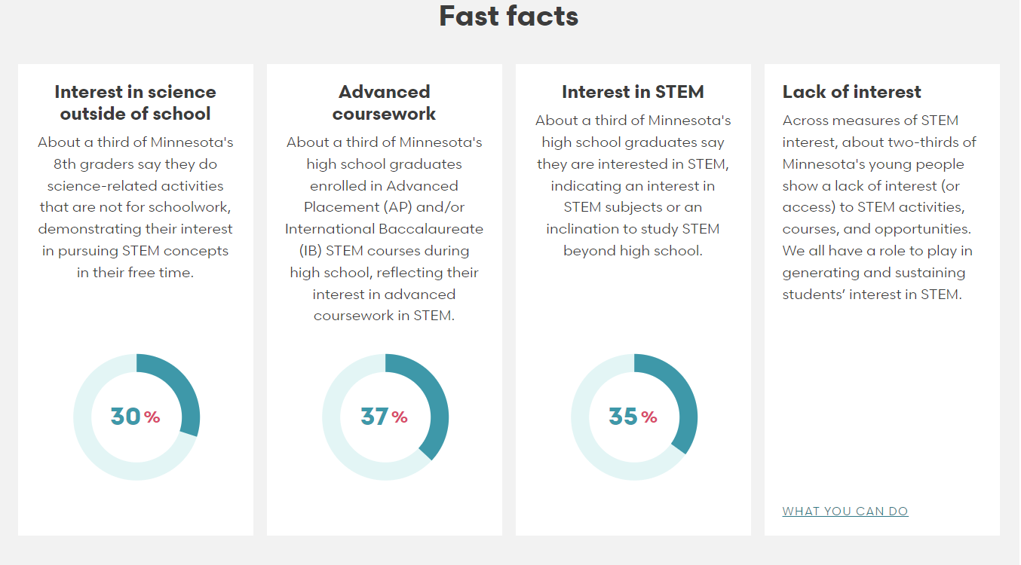
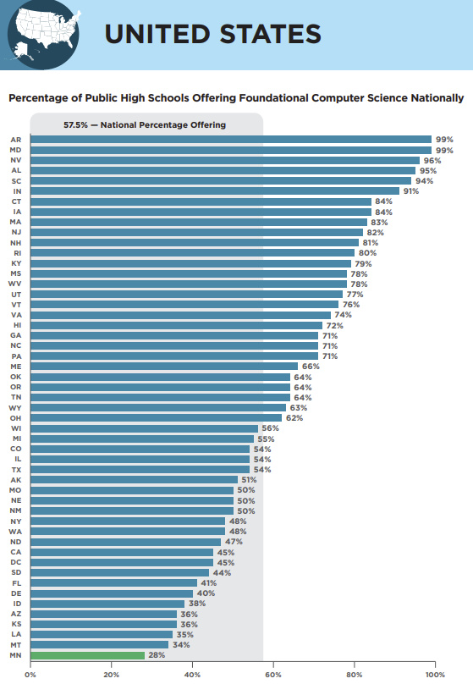
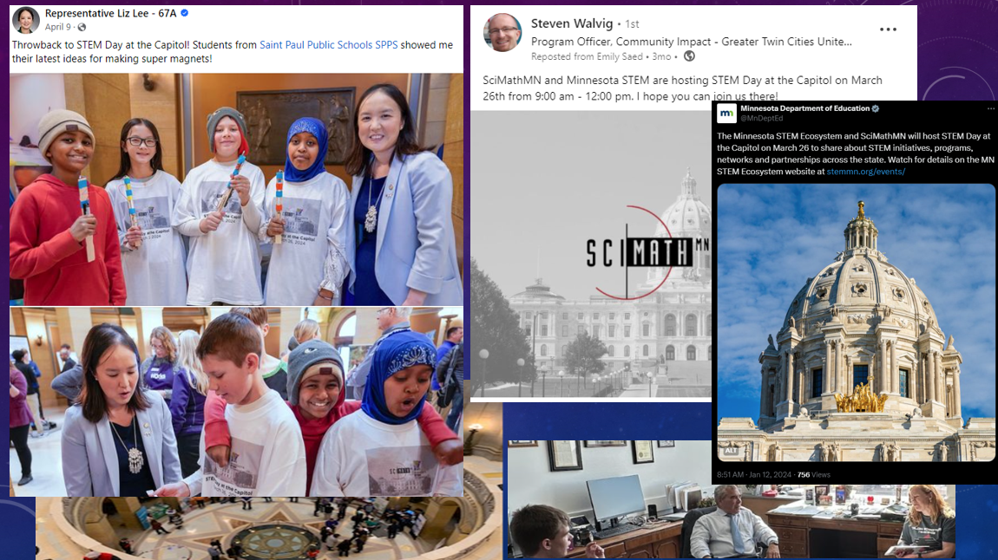
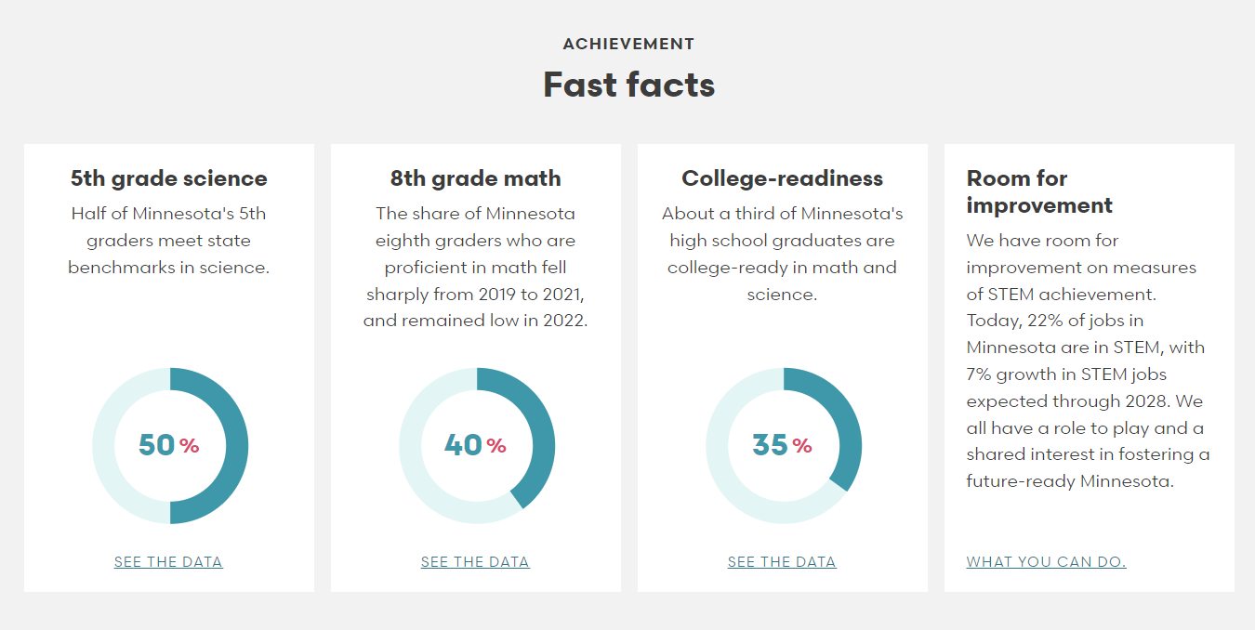
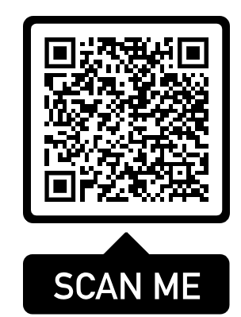
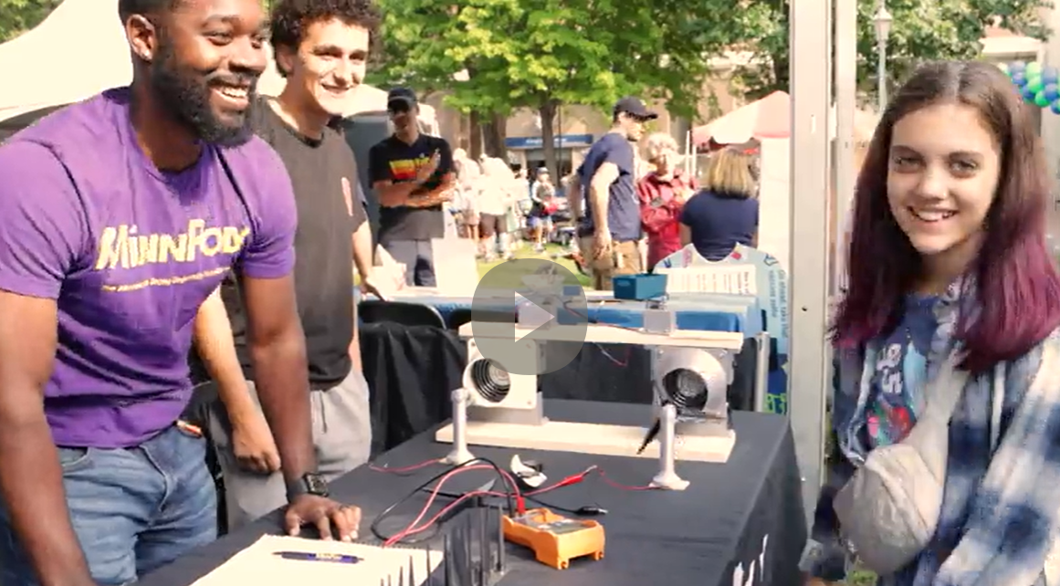
SciMathMN
Minnesota
Sarah Ness, Board Chair, and Emily Kinny Board Vice-Chair
About
State of Minnesota STEM
Signature Programs
Mission
SciMathMN advocates for effective, engaging, and rigorous STEM education opportunities for all Minnesota students, preparing them for citizenship, career, and college.
SciMathMN brings together a statewide STEM community to promote equitable and accessible STEM learning and workforce participation, empower lifelong learning, and inspire informed community action.
STEM Identity
Our major initiatives include:
STEM Advocacy – a collaborative effort to ensure equitable access to high-quality professional development for educators, integrated classroom instruction that inspires, and out-of-school experiential learning opportunities for all students aligned with the Future of Work readiness skillset and mindset needs of employers, and aware of emerging tech and AI advancements affecting the global economy.
STEM Day at the Fair – a “You Belong in STEM” community gathering that engages 17,000 annually in Minnesota’s premiere STEM education awareness, experiential learning, and employment opportunity celebration.
Minnesota STEM Teacher Center – a highly successful award-winning online resource for teachers, administrators, and parents that provides teaching tools for Minnesota’s ever-evolving math and science standards;
Conferences and Convener Events – an intentional effort to inform legislators and other constituents about regional and national developments in quality STEM teaching and learning, landscape changes in Minnesota, and opportunities to exchange ideas and create new ways to showcase STEM across the state.
We are deeply committed to ensuring that all Minnesotans are integrated into the dynamic STEM ecosystem- ready for life, impactful work, and citizenship.
STEM Interest
Computer Science “First to Last!”
Coming This Year
Celebrating 15 years of STEM Day at the Fair
“I am a parent of an 8th grader at Minneapolis Public Schools who is completely “into” STEM. Every year we go to the first day
of the State Fair specifically for STEM Day! So THANK YOU for putting together such a fabulous event.” –Eddie
“ I realize I’m just a mom that happened by your area at the fair on Thursday, but I just had to thank you so much for an incredible day at the fair. My family of 3 boys are still talking about all the displays and experiments they participated in. We spent hours going through every booth. Everyone working was so engaging and patient. Every booth had interesting content and activities. Just had to say Thank you, thank you, thank you!!”- Erin
Achievement
STEM Advocacy (Educator and Student Advocacy Tool Kit)
STEM Day Celebration (Nov 8th,2024)
State STEM Conference (Spring 2025)
STEM Day at the Capitol (Spring 2025)
STEM Day at the Fair (Aug 21, 2025!)
STEM Awards (New Spring 2025)
Source: https://www.mncompass.org/stem-minnesota
Source: https://advocacy.code.org

